Slide 1
PREVENT SUICIDE TODAY
Hope Resilience Belonging
Notes:
Welcome! Thank you for joining us today for this SuicideTALK.
My name is... I am... I am also an ASIST trainer. ASIST is an acronym for Applied Suicide Intervention Skills Training.
We are here today with our Prevent Suicide Today program.
We have been working in Chatham County, Georgia since 2017 in partnership with Gateway Community Service Board and other diverse community partners. Together we are implementing international evidence-based trainings. One of them is SuicideTALK, which is the topic of our discussion today. The other is ASIST, which is a 2-day skills-based workshop. We’ll spend more time talking about ASIST at the end of our session today.
We are glad and thankful that you’ve joined us for today’s presentation. I am sure that there are people here for variety of reasons.
Some of you may want more information about suicide prevention in our community.
Some of you listening may be worried that you or someone you know may be at risk of suicide.
I am sure that there are some who have been impacted by suicide as well.
This session is aimed at our entire community because we think that by working together we can prevent suicide together.
It is our goal for everyone to know that help is available and where to find it.
Also, in the end, if we have time left we can answer some of your questions. So please if you have any questions, submit them throughout the presentation and we’ll try to address them at the end.

Slide 2
If you are having thoughts of suicide or need immediate assistance, please call the Georgia Crisis and Access Line at 1-800-715-4225
LEARNING OBJECTIVES
suicideTALK participants will:
Understand the impact of suicide in our community.
Explore how personal and community beliefs about suicide affect suicide stigma and safety.
Learn how to take the first steps toward suicide prevention.
Contribute to suicide safety in the community.
Notes:
SuicideTalk is about dealing openly with the stigma around suicide.
It focuses on the question "Should we talk about suicide?"
By looking at this question in a number of different ways, we hope that we can help you discover some of the beliefs and ideas about suicide in your communities—and in yourselves.
As suicideTALK participants you will learn…
How suicide is a serious community health problem and how it impacts our entire community
Together we will we explore how personal and community beliefs about suicide affect suicide stigma and safety
And we will learn how to take the first steps to help prevent suicide and create a suicide-safer community.

Slide 3
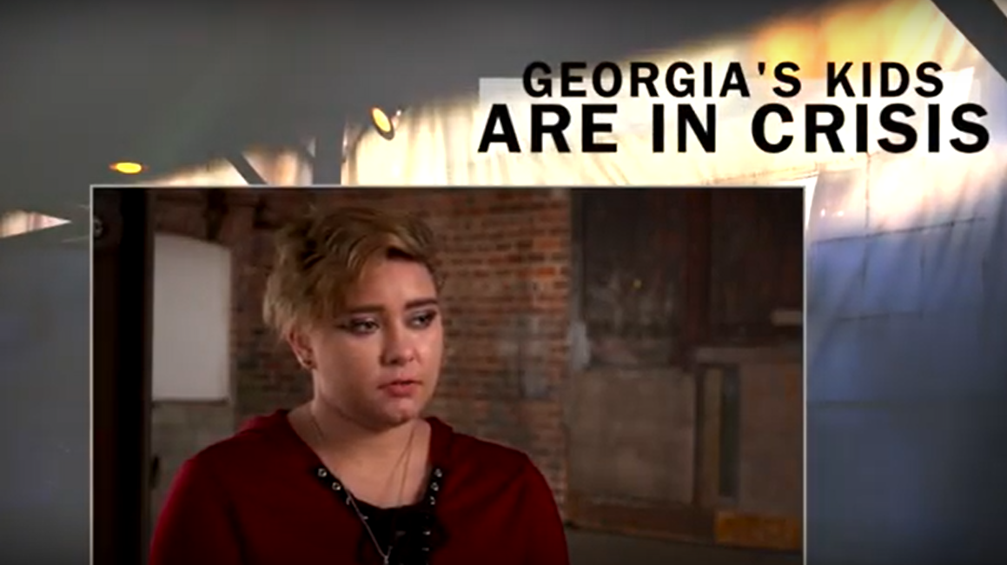
Youth Suicide Prevention: "Georgia's Children in Crisis"
Notes:
90 Second PSA: https://www.youtube.com/watch?v=1wssG_Bgp3k

Slide 4
Notes:
So let’s begin with looking at numbers – statistics – which speak quite loudly and help us better understand the impact of suicide on communities at large as well as individuals.
First, we’ll look at the bigger picture – national data on suicide, and then gradually we’ll narrow it down to State and Chatham county level.
According to the latest report by the Centers for Disease Control and Prevention (CDC) that was just released in June this year…
Suicide rates have been rising in nearly every state and in half of states suicide rates went up more than 30% since 1999.
In 2016, nearly 45,000 Americans age 10 or older died by suicide.
Suicide is the 10th leading cause of death and is one of just three leading causes that are on the rise.
The conservative estimate is that for every death by suicide 25 or more people attempt.
In addition to the tremendous emotional cost of suicide there is also an economic impact in medical costs for individuals and families,
lost income for families, and lost productivity for employers. Suicide is estimated to costs the US $69 billion annually.
--
Source: American Foundation for Suicide Prevention https://afsp.org/about-suicide/suicide-statistics/

Slide 5
CDC Youth Risk Behavior Survey National Statistics 2017
17.2% of students had seriously considered attempting suicide
13.6% of students had made a plan about how they would attempt suicide while 7.4% of students had actually attempted suicide one or more times
Female students were twice as likely as male students to have seriously considered attempting suicide
31.5% of students had felt so sad or hopeless almost every day for 2 or more weeks in a row that they stopped doing some usual activities
Lesbian, gay, and bisexual youth seriously contemplate suicide at almost three times the rate of heterosexual youth.
Notes:
Also, while we are talking about the national statistics, we thought it would be important to include the following slide describing suicide rates among the youth.
This survey was completed with U.S. high school students (9th – 12th grade) in public and private high schools throughout the U.S. in 2017
Few that we’d like to highlight from the most resent CDC report is that in 2017
Over 17% of students had seriously considered attempting suicide
Almost 14% of students had made a plan about how they would attempt suicide while 7.4% of students had actually attempted suicide one or more times
Female students were twice as likely as male students to have seriously considered attempting suicide
Also, about one third of students had felt so sad or hopeless almost every day for 2 or more weeks in a row that they stopped doing some usual activities
Lesbian, gay, and bisexual youth seriously contemplate suicide at almost three times the rate of heterosexual youth

Slide 6
Notes:
Now let’s take a look at the Georgia statistics:
The suicide rate in GA has increased 16.2% since 1999.
Over the last year, there was a total of 1,409 reported deaths by suicide. I emphasize the word “reported” because sometime in cases were there might’ve been suicide, the cause of death is actually unclear.
Suicide is the 2nd leading cause of death for ages 25-34 and the 3rd leading cause of death for ages 15-24. Last year’s statistics indicated that suicide was the 3rd leading cause of death for ages 10-24.
Also, in Georgia twice as many people die by suicide as by homicide and nearly as many people die by suicide as by motor vehicle accidents.
On average, one person dies by suicide every six hours in Georgia.

Slide 7
Chatham County, 2017
45 Individuals lost
their lives to suicide
34 Men
11 Women
1,125 Attempted
Notes:
Now, let’s take a closer look at Chatham County, the community we have launched the Prevent Suicide Today program in, and how it has been impacted by suicide:
It is estimated, conservatively, that in 2016, almost twelve hundred people attempted suicide in Chatham County.
Reportedly, 47 people died by suicide. This compares to 54 deaths through motor vehicle accidents and 52 deaths by homicide in Chatham County.
Among those who lost t heir lives to suicide, there were twice as many males as females; 2 individuals were between ages 10 and 19.
Each of those 47 individuals had family, friends, co-workers, and others who were impacted by their death.
Suicide impacts us all as a community and these numbers, these people, these lives tell us that we, as a community, have a lot of work to do in suicide prevention.
So let’s take a moment and reflect on suicide’s impact in our own lives by thinking through the following questions:
Do you know someone who died or might have died by suicide?
Do you know someone who injured themselves with suicide in mind?
Do you know someone who has/had (or whom you now suspect has/had) thoughts of suicide?
Do you know someone, including you, who is or has been personally impacted by suicide?
In our Prevent Suicide Today work in the community, we see that for many people the answer to these questions is often a “yes”. It may be for you as well.
Source: Georgia OASIS Data, Suicide 2017 https://oasis.state.ga.us/oasis/webquery/qryMortality.aspx

Slide 8
For every one person that dies by suicide,
280 people think seriously about suicide but do not die.
Notes:
So yes, every single suicidal act has a lasting impact on those left behind. It is very likely that over our lifetime all of us will be touched by suicide, in one way or another.
Just recently many people felt the impact of suicide when the news reported the deaths by suicide of Kate Spade and Anthony Bourdain.
Now, what does that say about suicide? One of the things it says is that suicide can affect people from all walks of life and it could happen to any of us.
Acknowledging this helps us better understand the value of speaking openly about suicide. When we recognize the potential for suicide in everyone—in our coworkers, classmates, friends, family members, even ourselves—then we are more likely to do something to help prevent it.
Later in the session we will provide you with more information on how you can help prevent suicide in your community.

Slide 9
5 Common Misconceptions About Suicide
#1 People who talk about suicide won’t really do it.
FACT: As many as 75% of people who attempt suicide do or say something to indicate their state of mind and intentions before they act.
Notes:
Before we talk about prevention methods, we’d like to discuss some false ideas associated with people with suicidal thoughts.
To help someone at risk of suicide we need to separate myths from facts. That’s why it is important to recognize these misconceptions.
While there are many myths about suicide, we would like to highlight just five of the most common misconceptions:
#1 People who talk about suicide won’t really do it.
This is false.
According to research, as many as 75% of people who attempt suicide do or say something to indicate their state of mind and intentions before they act.
Talking about suicide may be a plea for help for those people.

Slide 10
5 Common Misconceptions About Suicide
#2 Talking about suicide may give someone the idea.
FACT: Asking someone about suicide will not "put the idea in their head." In fact, many people having suicidal thoughts often feel relieved when someone asks.
Notes:
#2 Talking about suicide may give someone the idea.
This is false
Research confirms that asking someone about suicide will not "put the idea in their head." In fact, many people having suicidal thoughts often feel relieved when someone asks. Talking about the possibility of suicide can be a first step in obtaining help.

Slide 11
5 Common Misconceptions About Suicide
#3 People who die by suicide were unwilling to seek help.
FACT: Studies show that more than half of suicide victims sought professional help within six months of their death.
Notes:
#3 People who die by suicide were unwilling to seek help.
This is false.
Studies show that more than half of suicide victims sought professional help within six months of their death.
On a side note, as we are talking about suicide in the community, to help focus on the person rather than their action, we say that a person died by suicide instead of committed suicide.
[Trainer note: In the suicide prevention field it is discouraged to use of the term “commit suicide.” The verb “commit” (when followed by an act) is generally reserved for actions that many people view as immoral or criminal. Someone commits murder, or rape, or perjury, or crime. The person who dies by suicide is not committing a crime. Rather, the act of suicide almost always is the product of intolerable stress, or trauma, or mental illness. To portray suicide as a crime stigmatizes those who experience suicidal thoughts or attempt suicide. This stigma, in turn, can deter people from seeking help from friends, family, and professionals.]

Slide 12
5 Common Misconceptions About Suicide
#4 If a person is going to attempt suicide, nothing will stop them.
FACT: Most who attempt suicide remain uncertain of the decision until the final moment. Most suicidal people don't wish for death – they wish for the pain to stop.
Notes:
#4 If a person is going to attempt suicide, nothing will stop them.
This is false.
Most who attempt suicide remain uncertain of their decision until the final moment. Most suicidal people don't wish for death – they wish for the pain to stop.

Slide 13
5 Common Misconceptions About Suicide
#5 Anyone who tries to kill him or herself has a mental health condition.
FACT: 54% of people who died by suicide did not have a known mental health condition.
Notes:
#5 Anyone who tries to kill him or herself has a mental health condition.
This is false.
Research shows, 54% of people who died by suicide actually did not have a known mental health condition, such as depression.

Slide 14
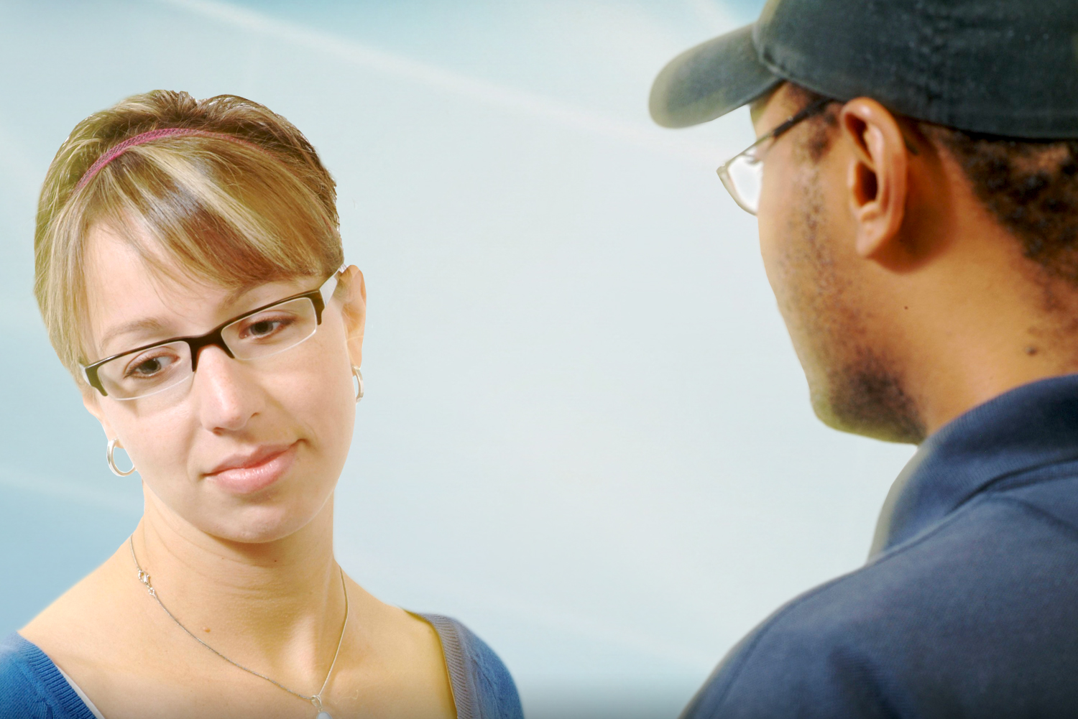
S*
Notes:
So let’s get comfortable being uncomfortable.
For many people suicide is that S* word they tend to avoid.
As a society, we resist talking about suicide for many different reasons.
It could be shame and stigma.
It could be the heaviness of the subject.
It could be the result of a personal experience.
Or it could be unconscious – many people avoid talking about suicide without realizing it.
So why should we talk about suicide?
Well, because talking about suicide is an effective way of preventing it.
By opening the dialogue, sharing our stories, and identifying resources we can reduce stigma and make it easier for people at risk of suicide to come forward and get the help they need.
[“Any ideas on why people avoid direct talk about suicide?” – let participants answer]
[So now I want you to practice to say the word “suicide” in a sentence.]

Slide 15
Notes:
Being a SuicideTALKer means speaking openly about suicide in a comfortable and thoughtful way.
Talking to someone about suicide doesn’t mean just using words – it means showing a caring attitude, using inviting body language, making an eye contact. It makes others more willing to talk with us about suicide when we don’t pass judgement, but show our sincere concern and care.
Our attitude is a little thing that can make a huge difference.
Do you think a person at risk of suicide would want to share their thoughts with us when our attitude is like “Why do you want to talk about this? This is stupid!” Probably not.
A person at risk of suicide is more likely to talk to us when we show that we are comfortable, respectful, and willing to talk about their thoughts and feelings about suicide.

Slide 16
Should I tell about suicide?
Should I ask about suicide?
Notes:
Sometimes we think of talking about suicide in terms of rights.
A person having thoughts of suicide may wonder:
Do I have the right to involve someone in my problems?
Do I have the right to ask for help?
While a person who wants to help may question:
Do I have the right to "put my nose" in someone else's business?
Do I have the right to ask about suicide?
The truth is that most of the time, talking opportunities are not about the right to privacy, the right to non-interference or the rights to seek or give help.
They are not about rights at all. They are about needs and invitations to meet those needs.
A person at risk is in pain. They want others to notice it. So they send out invitations to talk openly about it.
As a person who wants to help, you receive these invitations and you have to decide whether or not you are going to accept and act upon them.

Slide 17
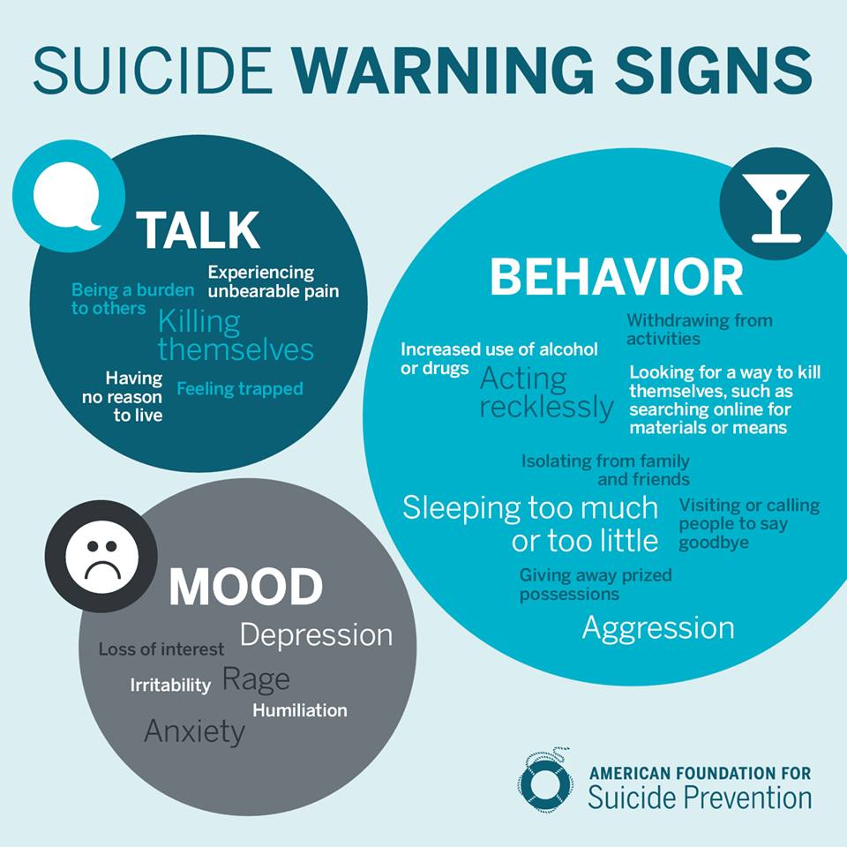
Notes:
These invitations we are talking about are also known as warning signs.
Most people who take their lives exhibit one or more warning signs, either through what they say or what they do.
It is important to look for a change in behavior or the presence of entirely new behaviors, especially when related to a painful event, loss, or change.
Common warning signs include:
A sense of hopelessness
Isolation
Aggression and irritability
Possession of lethal means
Feeling like a burden
Drastic mood changes
Frequently talking about death
Self-harm
Engaging in risky behaviors
Making funeral arrangements
Giving away things
Substance abuse
Direct threats of suicide
And low self-esteem
So now we are going to shift our perspective from helper to person at risk and discuss the needs of someone thinking about suicide.

Slide 18
TALK: I need to Tell
I need to openly Tell someone about my thoughts of suicide.
I would like to Tell several people.
I am aware that I may be cautious in saying it as openly as I want to.
I will be watching for reactions.
Notes:
We can remember these needs by using the acronym TALK.
T stands for TELL.
As a person thinking about suicide:
I need to openly Tell someone about my thoughts of suicide.
I would like to Tell several people.
I am aware that I may be cautious in saying it as openly as I want to.
I will be watching for reactions.
So why would a person at risk tell anyone what they are thinking?
If they really wanted to die, why tell someone that might stop them?
There really seems to be only one possible answer. Part of them is still unsure about death.
They are undecided and the mere fact that they are still alive says that they have a connection to life.
A person who wants help and cannot decide, really has a need to reach out for someone to talk to.
If you are having thoughts of suicide (or if you think you ever could come to that point), there is one very important thing you can do to help yourself.
Don’t face suicide alone. Tell someone… Several potential helpers are always better.
By demonstrating that we are comfortable and willing to speak about suicide we make it easier for the person at risk to meet their need to tell.

Slide 19
TALK: I need someone to Ask
Once I have given you any reason to think that I might be thinking about suicide, please Ask me exactly about suicide.
Ask me as directly, clearly and as soon as you can.
Right now that is exactly what I want to you do.
Notes:
A stands for ASK
As a person thinking about suicide:
I need someone to Ask.
Once I have given you any reason to think that I might be thinking about suicide, please Ask me exactly about suicide.
Ask me as directly, clearly and as soon as you can.
Right now that is exactly what I want to you do.
Even when invitations are obvious, some may avoid direct talk about suicide for fear that it is too personal to talk about directly.
But asking about suicide is a “win/win” situation.
If thoughts of suicide are present then we know what we are dealing with.
However, if they are not thinking about suicide, now they know that you are someone who cares and someone they can talk to.
Asking directly about suicide means exactly that – asking a person “Are you thinking of suicide?” or “Are you thinking of killing yourself?”

Slide 20
TALK: I need someone to Listen
I hope you are a good Listener.
I hope you will Listen to what I need to say, not to what you might like me to say.
I have not really talked to anyone about suicide.
I need to clear my thoughts by talking through them.
Notes:
L stands for Listen
As a person thinking about suicide:
I need someone to listen.
I hope you are a good Listener.
I hope you will Listen to what I need to say, not to what you might like me to say.
I have not really talked to anyone about suicide.
I need to clear my thoughts by talking through them.
Can you sense how alone a person at risk might feel?
Now think about them being alone and having to make a life or death decision.
Let's explore how much of a difference it can make if the person at risk can remember some of their strengths and reasons for living, sort out some priorities , and make some commitment to staying alive at least for now.
Almost all persons at risk have not fully decided that they want to die.
Instead, they want to talk to somebody about their feeling of not wanting to live.
People at risk can often talk themselves out of acting on their thoughts of suicide.
As long as you listen and keep the conversation going, you help meet their need.

Slide 21
TALK: I need help Keeping Safe
I don’t know what to do.
Can you help me think about what needs to be done?
Can you help me avoid dangers I may not fully recognize?
Notes:
K is for Keep Safe
As a person thinking about suicide:
I need help keeping safe.
I don’t know what to do.
Can you help me think about what needs to be done?
Can you help me avoid dangers I may not fully recognize?
People at risk of suicide often feel overwhelmed. They may feel that they have a lot to deal with and don’t know where to start.
The person at risk needs someone who understands that the first priority is safety from suicide and that everything else is secondary.
This translates into something like this: “Yes later you can think about that or work on that but today let’s do X, Y and Z to keep you safe.”
This perspective includes understanding that any means of suicide should be removed, whenever possible.
It also means that thoughts of suicide cannot be kept secret.
A helper should never be the only helper.

Slide 22
I need to Tell someone about
my thoughts of suicide.
I am open to your need to Tell me.
I need someone to Ask me about my
thoughts of suicide.
I am willing and able to Ask you directly.
I need someone to Listen to my
thoughts and feelings
about suicide.
I am willing and able to Listen to your
thoughts and feelings about suicide.
I need help Keeping Safe
from suicide.
I am willing and able to help you Keep Safe.
Notes:
22
So let’s review the needs of the person at risk and how we can help meet those needs.
I need to Tell someone about my thoughts of suicide.
I am alert to your needing to tell me.
I need someone to Ask me about my thoughts of suicide.
I am willing and able to Ask you directly.
I need someone to Listen to my thoughts and feelings about suicide.
I am willing and able to Listen to your thoughts and feelings about suicide.
I need help Keeping Safe from suicide.
I am willing and able to help you Keep Safe.
Please note that this is not a comprehensive intervention model. This is just an illustration showing that it’s possible to meet the needs of the person at risk, and that by doing so it is possible to prevent suicide.

Slide 23
#BeThe1To
ASK Ask the question “Are you thinking about suicide?”
KEEP THEM SAFE Find out a few things to establish immediate safety.
BE THERE Show your support.
HELP THEM CONNECT Connect with ongoing supports.
FOLLOW UP Check in to see how they’re doing.
Notes:
In addition to the TALK acronym and as a summary of what we’ve just discussed, we’d like to share another resource for suicide prevention.
This simple 5-step guide is an effective tool supported by evidence in the field of suicide prevention.
So let’s go over each step.
Ask: Ask the question “Are you thinking about suicide?” It communicates that you’re open to speaking about suicide in a non-judgmental and supportive way.
Keep them safe: After the “Ask” step, and you’ve determined suicide is indeed being talked about, it’s important to find out a few things to establish immediate safety. Have they already done anything to try to kill themselves before talking with you? Does the person experiencing thoughts of suicide know how they would kill themselves? Do they have a specific, detailed plan? What’s the timing for their plan? What sort of access do they have to their planned method?
Be there: This could mean being physically present for someone, speaking with them on the phone when you can, or any other way that shows support for the person at risk.
Help them connect: Helping someone with thoughts of suicide connect with ongoing supports (like the Lifeline) can help them establish a safety net for those moments they find themselves in a crisis.
Follow up: After your initial contact with a person experiencing thoughts of suicide, and after you’ve connected them with the immediate support systems they need, make sure to follow-up with them to see how they’re doing.

Slide 24
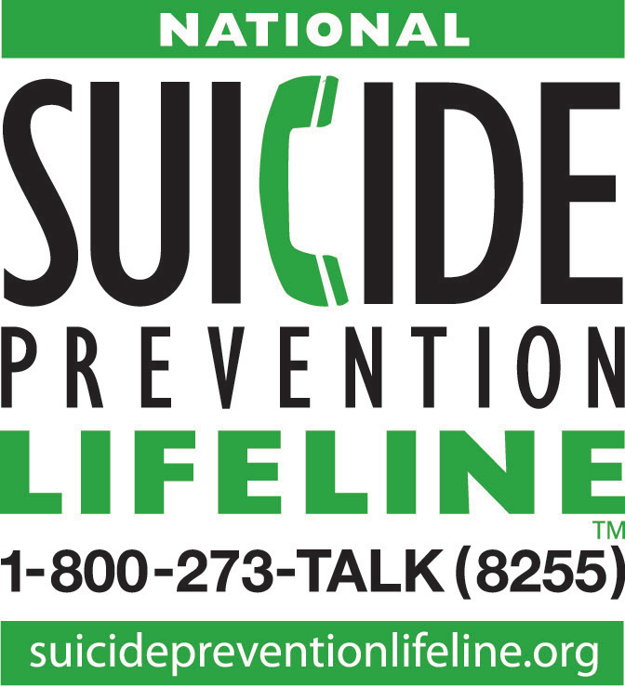
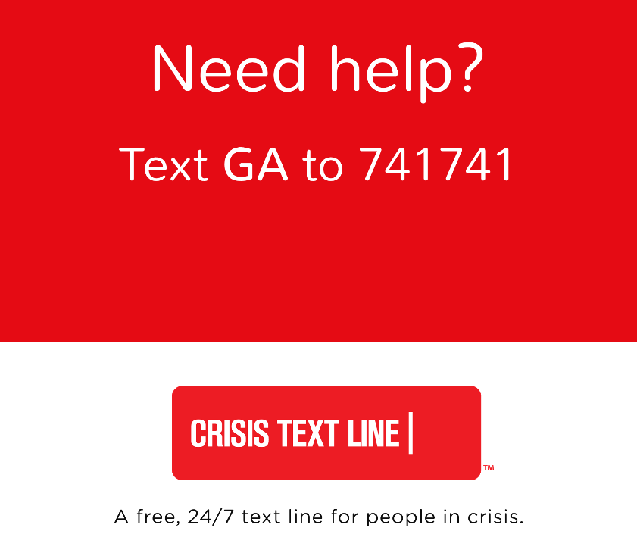
COMMUNITY RESOURCES
Notes:
Effective suicide prevention requires multiple approaches.
Knowing your resources to help you take effective action is a key to creating suicide safer community.
Showing on your screen right now are few resources that we would like to discuss.
The Georgia Crisis and Access Line (also known as GCAL) is
the 24/7 hotline
for accessing mental health services in Georgia
It’s run by the Georgia Department of Behavioral Health and Developmental Disabilities .
You can call GCAL at any time any day of the year. GCAL professionals can:
Provide crisis intervention services over the phone
Dispatch mobile crisis teams
Assist individuals in finding an open crisis or detox bed across the State
And link individuals with urgent appointment services
In addition, GCAL can help you access a State Funded provider in your area in a non-emergency situation.
The Georgia Crisis Text Line is another free, 24/7 support for those in crisis. Simply Text “GA” to the number 741741 and you will be connected to Trained Counselors in Georgia.
This is a great resource for anyone working with youth
Who may feel more comfortable texting
The National Suicide Prevention Lifeline is a national network of local crisis centers. It provides free and confidential emotional support to people in suicidal crisis or emotional distress. It is also open 24 hours a day, 7 days a week. They also have a chat option available through their website.
Finally, Veterans Crisis Line is the same phone number as the Lifeline, but you’ll choose option 1 when you dial that number.
We encourage you to program these numbers into your phone and be a resource in your community!
On our suicideTALK Webinar webpage, we have a resource flyer available for download. It’s called Helpers in Your Community. It includes resources for Chatham County and national hotline resources.
As a follow-up to this webinar we will be sending out an email with a link to this page. And of course, please let us know if there are any other resources we should add to this.

Slide 25
​
Things that sustain my life...
​
Meditation
Family
Goals
​
Friendship Job Pets Faith Hobbies
Notes:
As we are talking about building a suicide safer community,
We think that it’s important to talk about things we can do to promote our own mental health and wellbeing.
This can help to promote an overall healthier community and actually also help to protect against suicide.
The current slide describes some of the things that may be -- what we call – life sustainers. It may mean different things for you.
Some of you may sustain your life by doing your favorite activities, spending time with your loved ones, eating your favorite food…
For those of us here in Chatham County it could be going to the beach!
Whatever it is, we encourage you to take time for yourself and do the things that you love.

Slide 26
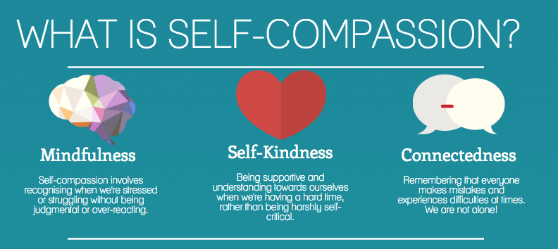
selfcompassion.org
With self-compassion, we give ourselves the same kindness and care we'd give to a good friend.
Notes:
Self-compassion involves acting the same way towards yourself when you are having a difficult time, fail, or notice something you don’t like about yourself. Instead of just ignoring your pain with a “stiff upper lip” mentality, you stop to tell yourself “this is really difficult right now,” how can I comfort and care for myself in this moment?
Instead of mercilessly judging and criticizing yourself for various inadequacies or shortcomings, self-compassion means you are kind and understanding when confronted with personal failings – after all, who ever said you were supposed to be perfect?
1. Self-kindness vs. Self-judgment.
Self-compassion entails being warm and understanding toward ourselves when we suffer, fail, or feel inadequate, rather than ignoring our pain or flagellating ourselves with self-criticism. Self-compassionate people recognize that being imperfect, failing, and experiencing life difficulties is inevitable, so they tend to be gentle with themselves when confronted with painful experiences rather than getting angry when life falls short of set ideals. People cannot always be or get exactly what they want. When this reality is denied or fought against suffering increases in the form of stress, frustration and self-criticism. When this reality is accepted with sympathy and kindness, greater emotional equanimity is experienced.
2. Common humanity vs. Isolation.
Frustration at not having things exactly as we want is often accompanied by an irrational but pervasive sense of isolation – as if “I” were the only person suffering or making mistakes. All humans suffer, however. The very definition of being “human” means that one is mortal, vulnerable and imperfect. Therefore, self-compassion involves recognizing that suffering and personal inadequacy is part of the shared human experience – something that we all go through rather than being something that happens to “me” alone.
3. Mindfulness vs. Over-identification.
Self-compassion also requires taking a balanced approach to our negative emotions so that feelings are neither suppressed nor exaggerated. This equilibrated stance stems from the process of relating personal experiences to those of others who are also suffering, thus putting our own situation into a larger perspective. It also stems from the willingness to observe our negative thoughts and emotions with openness and clarity, so that they are held in mindful awareness. Mindfulness is a non-judgmental, receptive mind state in which one observes thoughts and feelings as they are, without trying to suppress or deny them. We cannot ignore our pain and feel compassion for it at the same time. At the same time, mindfulness requires that we not be “over-identified” with thoughts and feelings, so that we are caught up and swept away by negative reactivity.

Slide 27
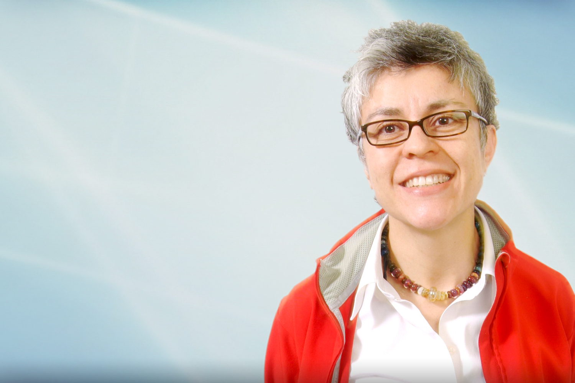
Things I might want to do…
Practice caring for yourself
Ask for help when needed
Volunteer to tell your story
Identify helpers and supports
Cultivate kindness
Notes:
So here are some ideas of the things you might want to do:
You can
Practice caring for yourself
Ask for help when needed
You can
Volunteer to tell your story about overcoming adversity; As you’ve learned today, many of us have likely been impacted by suicide in some way. Sharing our stories and experiences lets others know that it’s okay to do that and helps them share their own.
You can also
Identify community resources and share those resources with others. As we mentioned earlier, feel free to use and share the resources from our website.
Also, depending on what you do, you may be able to influence policies and procedures at your organization with regard to suicide prevention.
Finally, cultivate kindness by being kind to others and yourself

Slide 28
Learning TOGETHER. Saving lives TOGETHER. Making a difference TOGETHER.
YOU + ME = US
Notes:
As we are concluding our suicideTALK, we would like to thank all of our community partners for making this program possible and for working together to prevent suicide in Chatham. We couldn’t do it without them!

Slide 29
AS A COMMUNITY WE CAN WORK TO PREVENT SUICIDE TODAY! Contact Information: ASIST@chlink.org 912-661-1456 QUESTIONS?
PreventSuicideToday preventsuicidetoday_chathamco
Notes:
Okay, so we have couple of minutes left.
We’d like to thank all of you for joining us for today’s suicideTALK webinar. Feel free to contact us with any questions and comments about suicideTALK and ASIST.
We will be sending you a follow up email with more information about our programs as well as a link to our website page with the resources.
Please follow us on Facebook and Instagram.
Thank you! Good-bye!

